Slide 1

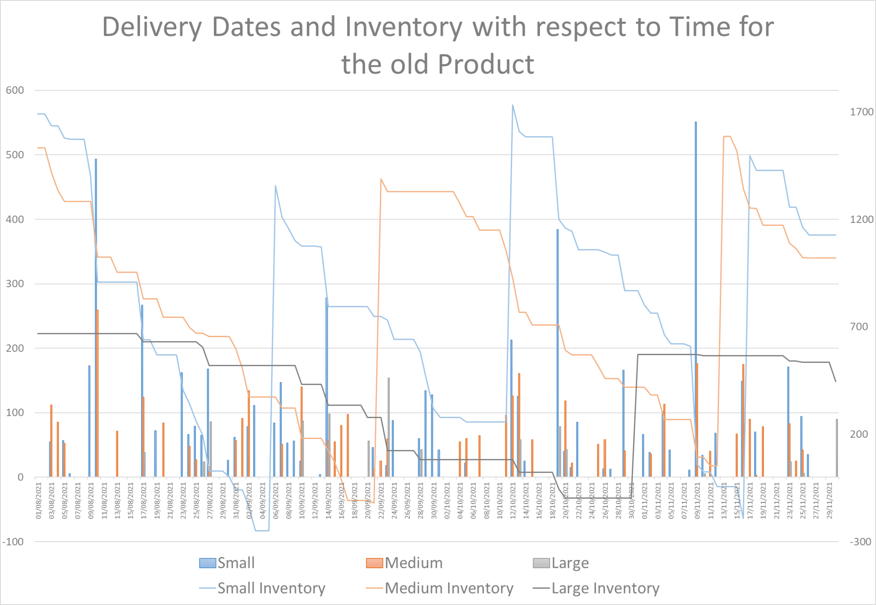
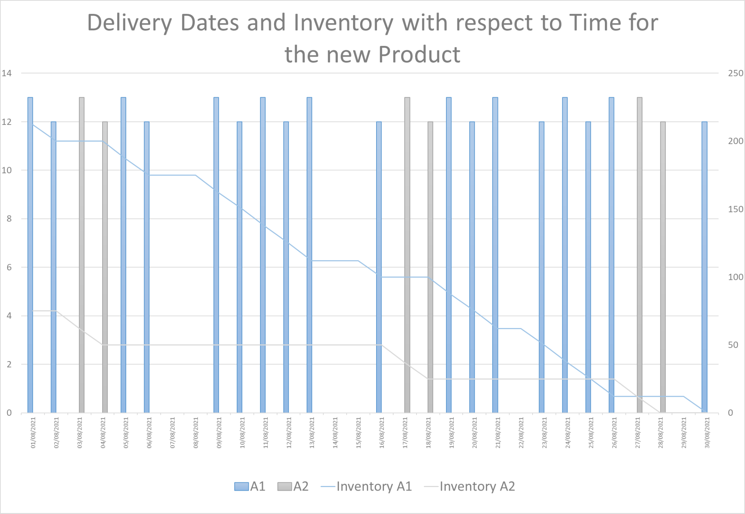
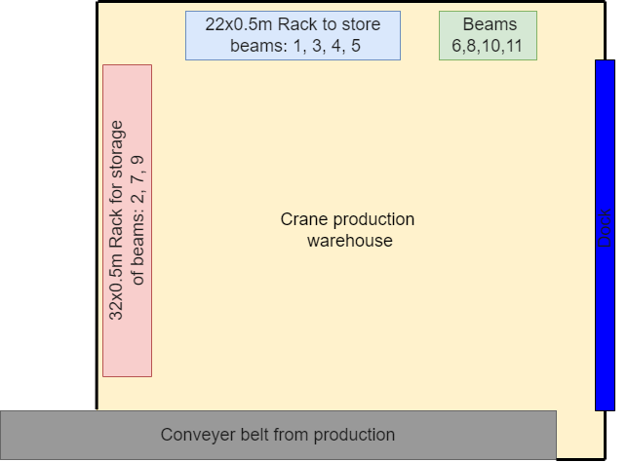
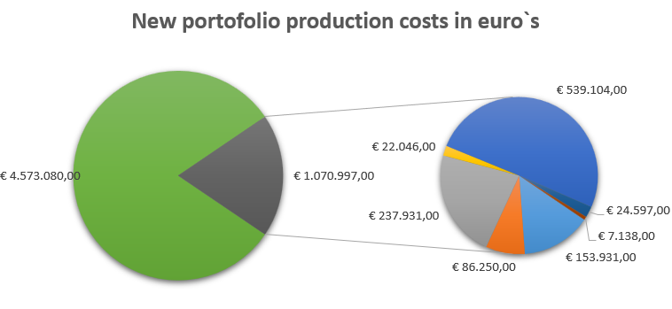
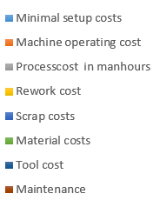
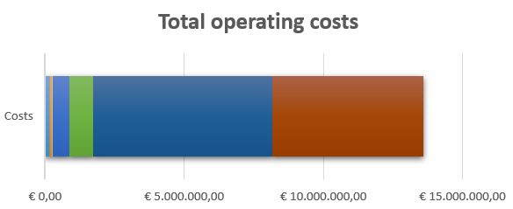
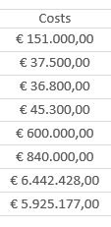
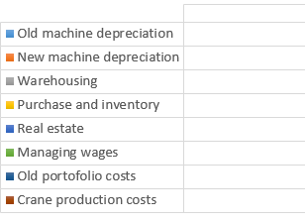
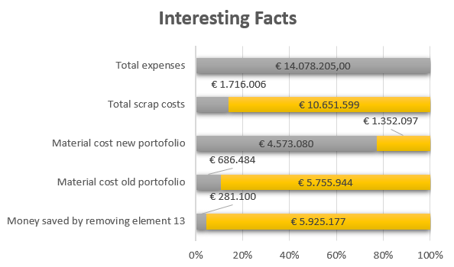
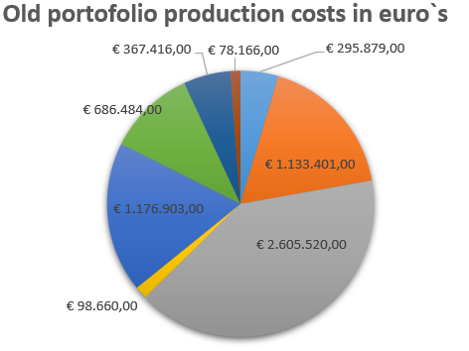
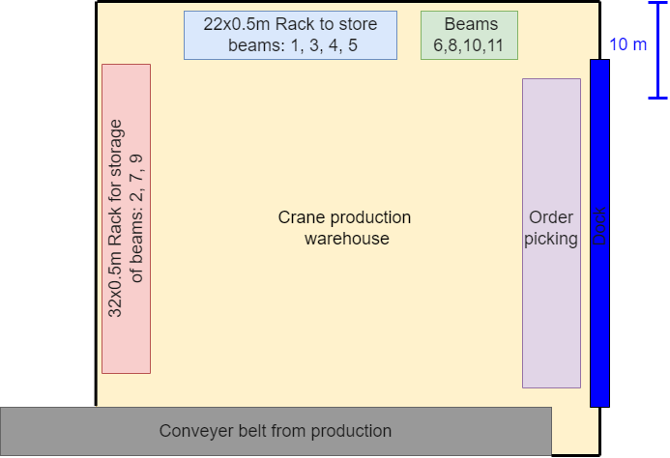
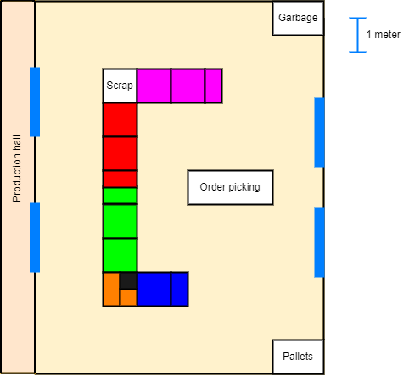
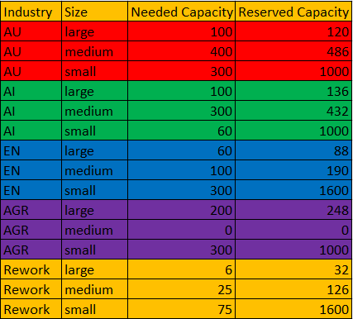
ME Module 11 : Production Systems Engineering
Group 2 | Faculty of Engineering Technology (ET)
University of Twente, Netherlands | 2022
Finance and inventory management
Name (s1234567),
Marco van Ginkel (s2168197),
Philip Teitink (s2271990)
Introduction
Requirements
The subsystem Finance and Inventory Management focuses on the financial aspects and the keeping of inventory. As a result, this subsystem creates a thorough cost estimation of both running factory and the initial costs of building it. Within the estimation of the running costs a model regarding the keeping of inventory is included. With the use of this model the EOQs and ROPs of the different material types are visualised. Furthermore, this subsystem also planned a layout for the warehouse according to the specifications of Process Design. This includes an estimation of spaces required for the different products and their method of storage. All these aspects are repeated for the new line that will be used for the STS-crane manufacturing. Finally, with an comprehensive estimation of both the revenues and costs it is possible to conclude the breakeven period of the new factory. On top of that, it can be discussed whether this new factory is financially sound for the future of Etone.
Old portofolio warehousin
F Regular and reliable raw material order patterns with a < 10% variation
F Safety Stock: <5% of the yearly demand, not more than 5% of the ordered raw materials is unused
NF Order delivery: specified delivery dates and number of parts are met with minimal variation (ensure by keeping safety stock) == dependability
NF Minimize cost due to inventory and warehousing
F Investments should reach the breakeven point in 5 years
F Standard working days 250 per year , 174 hours/month
F Use working wages in accordance with current CAO for metalworking company
NF== non functional requirement F== Functional Requirement
Old portofolio inventory
New portofolio inventory
The graph above shows both the inventory levels and the due dates of all three material types. The inventory levels have been estimated with the use of an EOQ, which is calculated through an estimation of the order and holding costs. The value of the EOQ is found to be 1690, 1532 and 668 respectively for the small, medium and large material. In the graph it can also be seen that the inventories go below 0 for 150, 40 and 50 units respectively. From this it can be concluded that a safety factor should be considered of 10, 5 and 10 percent on the first annual order for the different materials to ensure that enough material is always available and as such no downtime is introduced.
The graph above shows a similar visualisation of the inventory levels and the due dates with respect to time. The plan for the cranes is to produce 25 pieces of an element every two days, which results in 25 finished cranes at the end of the month. However, the different cross sections have been separated. As a result, it was determined that it would be most efficiently to order all material used during the month a week before the start of the month. This results in an EOQ of 225 and 75 for A1 (2400mm^2) and A2 (1600mm^2) respectively. Furthermore, the material necessary for the production of element 13 can be neglected as this beam has been removed from the design. On top of that a small safety stock is implemented of 5% of both material types. This will be ordered once a year, as it is assumed that there should be few fluctuations in production amounts.
Yearly costs per line
Overall costs per year
These graphs list the total operating costs according with some interesting facts. It can be seen that the production of both portfolios are the main expenses. However, from this table it can be seen that managers and real estate account for a lot of the costs as well. Together with the pie charts to the left, it can be seen that when parameters like scrap are reduced, the total operating costs will be highly reduced.
In these 3 pie charts the costs of both production lines can be seen. These costs are calculated based on the provided datasheets and some assumption based on known values. [1][2][3]
From these charts it can be seen that there is a huge difference in the build up of costs between both portfolios.
Crane production warehousing
For the storage of the newly produced crane parts a large warehouse is needed due to the length and manoeuvrability of these beams. Since the beams will not be lifted by hand it is possible to store these beams at height. The warehouse is designed to store 30 complete STS cranes, from which 25 will be shipped to ashdad monthly. A Forklift is used to transport the beams from the conveyer belt toward the racks. For the racks it is chosen to use one sided cantilever rack as these were most efficient. Order picking will be done directly in front of the wide dock, since trucks are likely to be loaded from their side.
Old portofolio warehousing
Dimensions:
40x40 meter
Conclusion
In order to make a profit the given price per part of the old portfolio should be 0.7 times the given amount + the material costs. For the new production this can be achieved by a price per part of two times the given amount + the material costs.
To check whether the safety stock requirement is met a monthly count is set up. From this it should be seen whether the current amount should last for the year. If this is not the case, then an additional supply can be ordered. Furthermore, the reduce an accumulation of stock the remaining stock at the end of the year should be subtracted from the to be ordered safety stock.
In order to successfully fulfill incoming orders, the warehouses have been designed to store at least 30% more than required. Care has been taken to minimise transport time between the production, warehousing and order picking.
Dimensions:
9x9 meter
The warehouse that holds the old portofolio is separated from the warehouse that houses the new portofolio due to the shear difference in partsize. It is chosen to place the racks in a U-shape. This, in combination with Gravity fed shelving, ensures that there is no interference between production and warehousing routes. In addition to this, Gravity fed shelving ensures that FIFO will be implemented, which although not vital for steel parts productions, may reduce scrap due to corrosion.
The layout of the racks is made such that all parts are ordered by industry, in the individual shelves the parts are then sorted on size and part number. This layout was chosen since orders often include different parts from the same industry, rather than the same size. Another feature of this layout is that the AU and AI parts are stored near the production hall, this is done since some parts are needed for subassemblies.
References: [1] https://www.schmiedekult.de/50-mm-Square-steel-steel-bar-iron-from-500-to-1500-mm
[2] https://www.fnv.nl/cao-sector/metaal/metaal-techniek/cao-metaalbewerkingsbedrijf
[3] https://www.machinemetrics.com/blog/tooling-costs
[4]
UNIVERSITY OF TWENTE.

